Slide 1
welcome to my
Presentation

Slide 2
MY daily life

Slide 3

Morning :I woke up early in the morning.

Slide 4
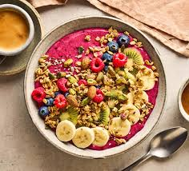
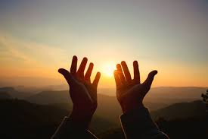
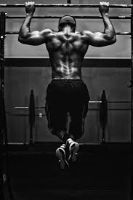
Prayer Time :
I do my prayer early in the morning. Then go for a work.then I take my breakfast.

Slide 5
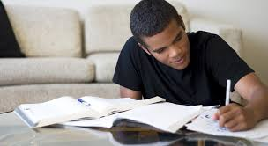
Study : I study from 8 to 10 am in the morning.

Slide 6

School : At 11am I go to school

Slide 7
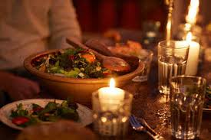

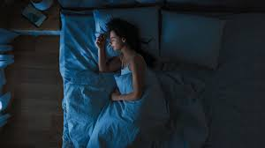
Night : At 7 pm I do my prayer and goes to reading room. At 10pm I take my breakfast and goes to sleep.

